Slide 1
Homeostasis and control systems

Slide 2
Internal Environment and Homeostasis
Total body water = 60 % BW
Extracellular fluid
Blood Plasma
1/5
1/3
Interstitial fluid
4/5
Intracellular fluid
2/3
= 40 % BW

Slide 3
all cells live in essentially the same ; ECF; internal environment of the body, or the milieu intérieur, ( claude bernard).
Differences Between Extracellular and Intracellular Fluids.
The ECF contains large amounts of sodium, chloride, and bicarbonate ions .
nutrients for the cells, such as oxygen, glucose, fatty acids, and amino acids.
It also contains carbon dioxide plus other cellular waste products
The ICF ; it contains large amounts of potassium, magnesium, and phosphate ions
Concentrations maintained due to special transport mechanims

Slide 4
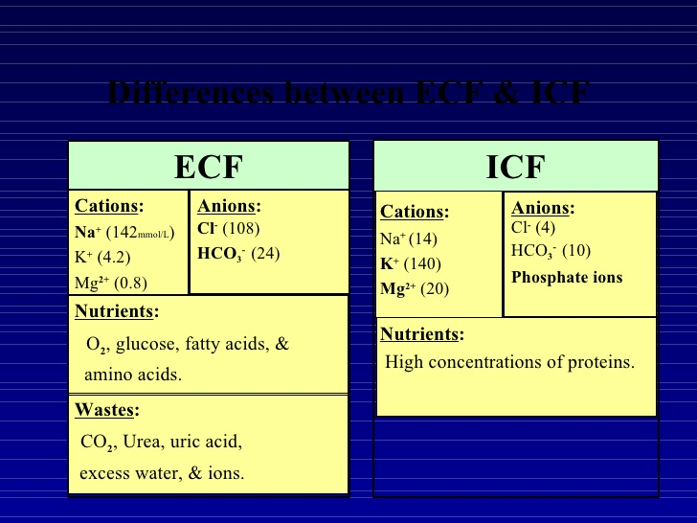

Slide 5
Homeostasis- constant internal environment
Extracellular Fluid (internal environment )Transport - Blood Circulatory System
ECF is transported all through the body .
HOW?
1- through the body in the blood vessels,
2- fluid movement between the blood capillaries and the intercellular spaces between the tissue cells.
Movement between plasma of blood and the interstitial fluid that fills the intercellular spaces.
Capillary walls are permeable to most molecules in the plasma of the blood, with the exception of the large plasma protein molecules.
Diffusion of molecules back and forth between the blood and the tissue spaces.

Slide 6
Where do nutrients in the ECF come from?
Respiratory System.
The blood picks up oxygen in the alveoli, thus acquiring the oxygen needed by the cells. Passing through alveolar membrane via diffusion
Gastrointestinal Tract.
Dissolved nutrients, including carbohydrates, fatty acids, and amino acids, are absorbed from the ingested food into the extracellular fluid of the blood.
Liver and Organs with metabolic function
The liver changes changes many of the GIT substances to more usable forms, so does- endocrine glands, adipose tissue.
Musculoskeletal System. ???

Slide 7
Removal of Metabolic End Products
lungs
Removal of Carbon Dioxide by the Lungs.
Carbon dioxide is the most abundant of all the end products of metabolism.
Kidneys
End products of cellular metabolism, such as urea and uric acid; excesses of ions and water from the food that might have accumulated in the extracellular fluid move from plasma to kidney
filters large quantities of plasma , reabsorption back into the blood ; those needed by the body, such as glucose, amino acids, appropriate amounts of water, and many of the ions.

Slide 8
Regulation of body systems
Nervous System.
sensory input portion, the central nervous system (or integrative portion), and the motor output portion.
autonomic system -subconscious level and controls many functions of the internal organs, including the level of pumping activity by the heart, movements of the gastrointestinal tract, and secretion by many of the body’s glands.
Hormonal System
endocrine glands that secrete chemical substances called hormones. Hormones control various functions of the body and are very crucial towards maintaining homeostatic function

Slide 9
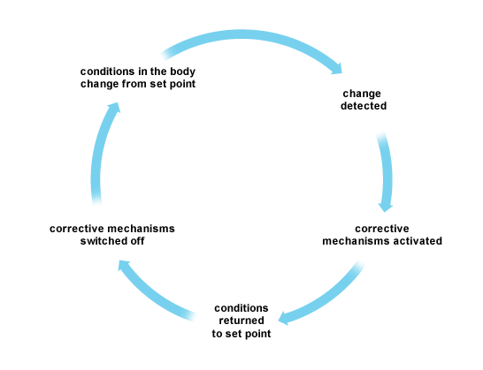
Control systems

Slide 10
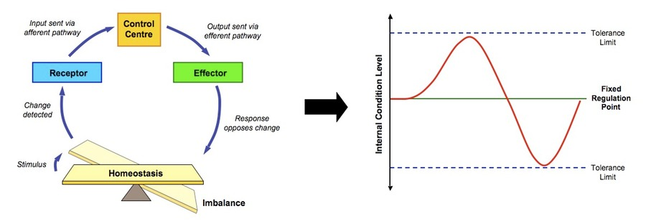

Slide 11
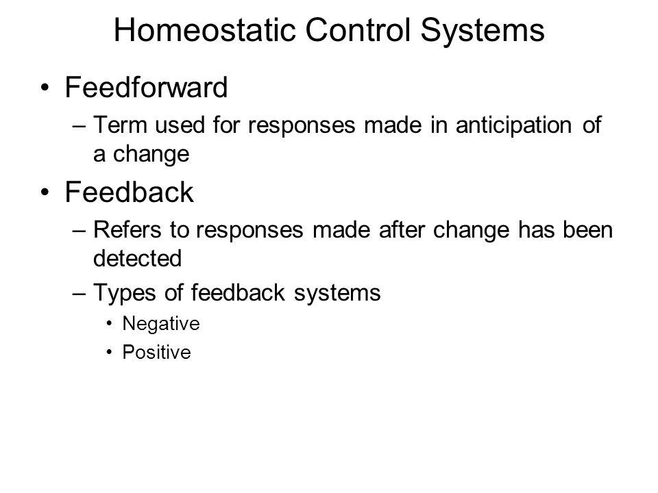

Slide 12
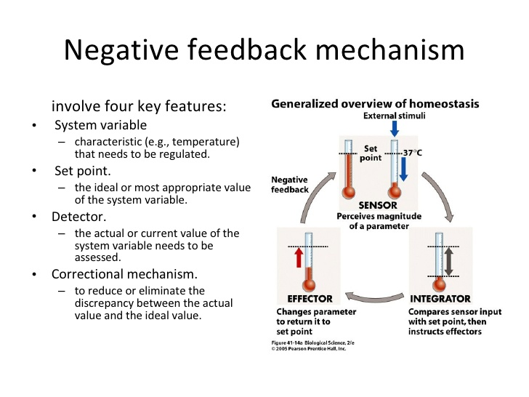

Slide 13
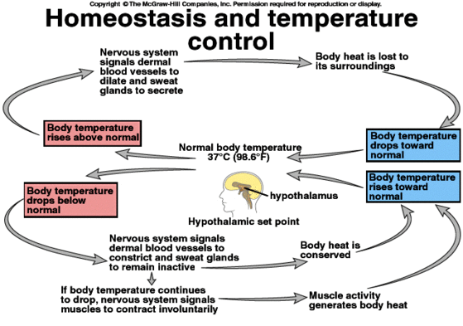

Slide 14
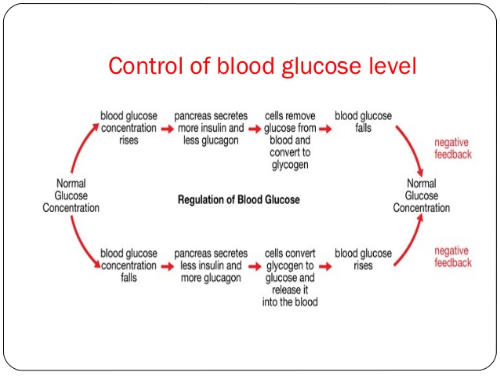

Slide 15
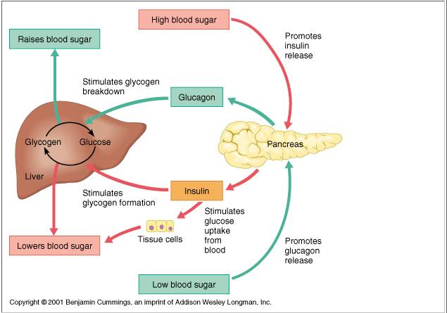

Slide 16
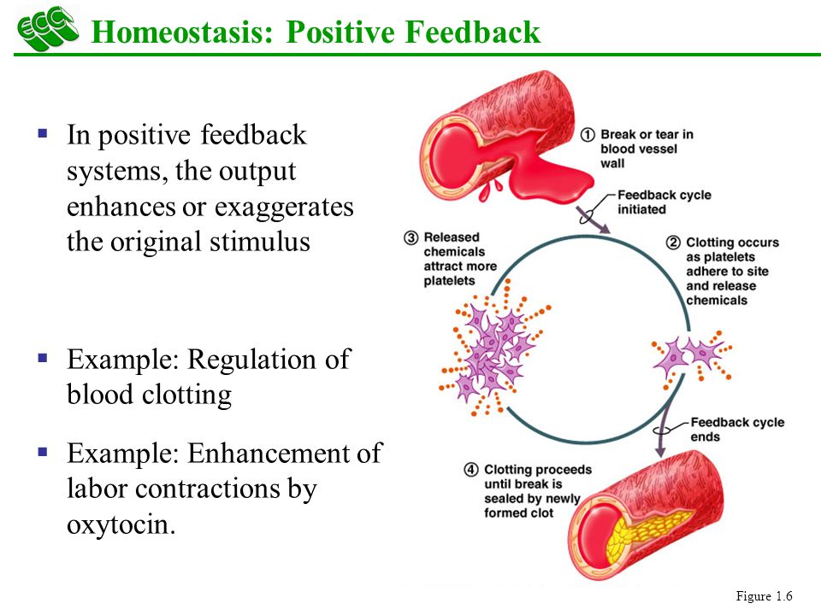

Slide 17
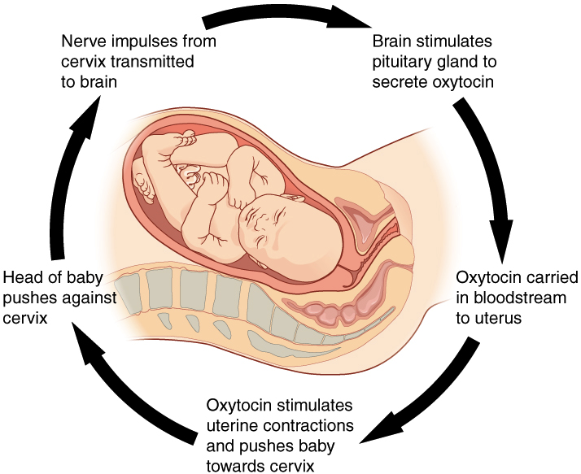

Slide 18
Feed-forward control
For instance, some movements of the body occur so rapidly that there is not enough time for nerve signals to travel from the peripheral parts of the body all the way to the brain and then back to the periphery again to control the movement.
Therefore, the brain uses a principle called feed-forward control to cause required muscle contractions. This is called adaptive control. Adaptive control, in a sense, is delayed negative feedback.

Slide 19
The cell

